Slide 1
Service Plan Spotlight
Critical Element 6-1

Slide 2
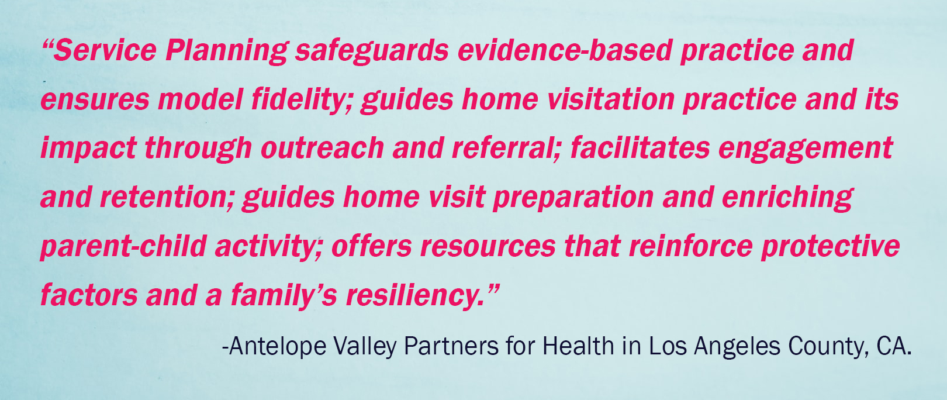

Slide 3

Service Plans provide road maps
Home Visit
CHEERS Check In
Depression Screen
More Visits
Enrollment
ASQ/ASQ SE
More Visits
Phone Visit
FROG Scale
More Visits
Creative Outreach
Graduation!

Slide 4

Service Plans are not related to Family Goals
Service Plans are for staff to:
Be intentional about reducing risk while building protective factors
Identify ways to promote nurturing and sensitive parent-child interactions
Support healthy child development and family functioning
Family Goals are for parents to:
Practice critical thinking and problem solving on something they truly want to accomplish
Experience safe, predictable, comfortable, and fun support from their FSS that engages their cortexes
Feel successful and competent
Family Goals do not include site or funder goals

Slide 5

Why was the Service Plan developed?
SUPERVISOR TOOL
Provide evidence of intentional work over the course of services
Reduce documentation
Integrate planning and support across multiple Best Practice Standards

Slide 6

Service Plans
  Are developed in collaboration between the Supervisor and Family Support Specialist
  Assist in sorting out bias
  Increase protective factors
  Build courage and strategies to address risk factors
  Support follow up and effective referrals when needed

Slide 7
1. Review & Discuss
What are you curious about?
What other information will be helpful?
2. Summarize the Strengths & Stressors
3. Plan & Pace
What reflective strategies apply?
What other activities or curriculum might apply?
What will be addressed first? What can be addressed over time?
4. Follow Up & Progress
Initial Service Plan

Slide 8
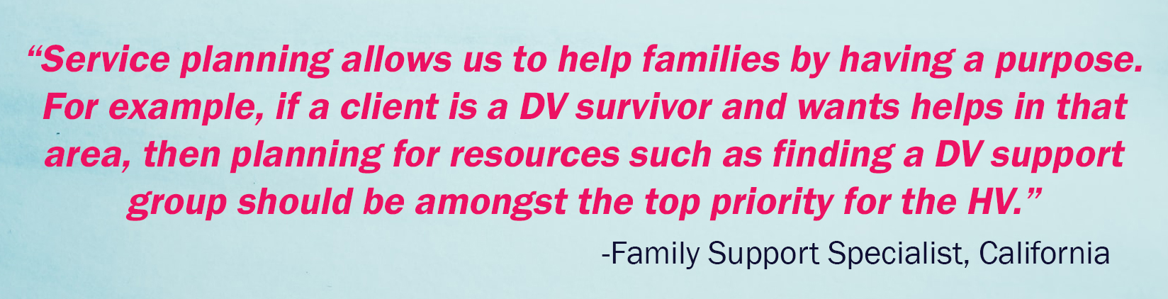
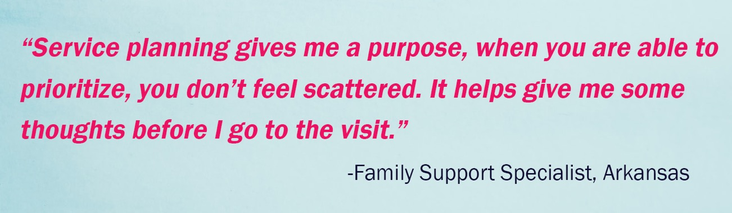

Slide 9
PROTECTIVE FACTORS & STRENGTHS | RISK FACTORS & AREAS FOR SUPPORT
Mom and Dad in love with baby | Mom not sure how to do potty training
Mom has thought about need for childcare | Mom is worried about setting up childcare
Service Plan
Examples
PLAN | PACE | PROGRESS
Learn more about the family, What I’d Like for my Child ATP when parents demonstrate love for baby | First month of visits Apr-May 2021 | 5/5/21 FSS used ATP when Dad held baby close, Dad looked at baby and smiled
Use PT re: what will help Mom with need for childcare Use FNT re: Mom worry about childcare | Priority 4/16/2021 | 4/30/21 FSS used FNT Mom says Dad is helpful. FSS used PT, Mom has contacted 2 centers. Childcare began 5/19/21
Use PT to explore parent’s thoughts about potty training | Spring 2022
6-1.C is an Essential Standard for the FSS to implement the plan with families over the course of services.

Slide 10

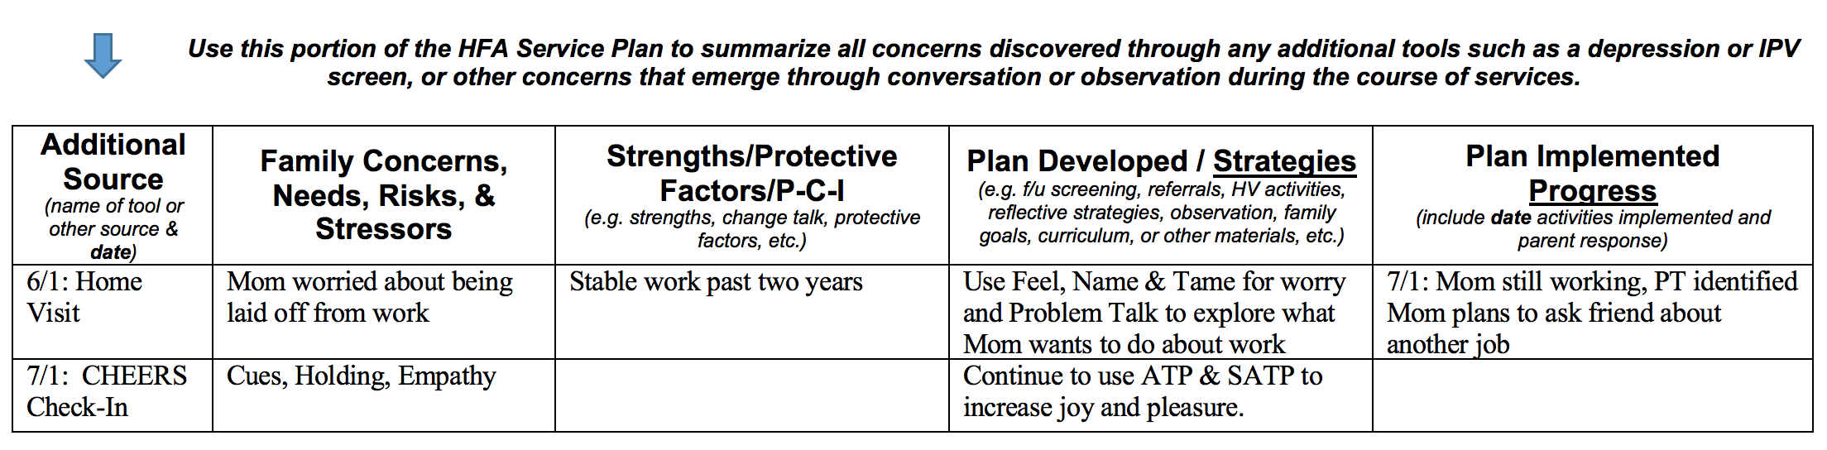
Ongoing Service Plan
5. Continued follow up and progress plus additional sources
See 7/7/21 Sup Note

Slide 11

Frequency of Service Plan Review during Supervision
Best Practice Standard 6-1.B Tip
Initial Service Plan: developed within 2 weeks of the Parent Survey/FROG Scale being completed
Levels 1, 1P, & SS: review once monthly
Levels 2, 3, & 4: review every other month

Slide 12
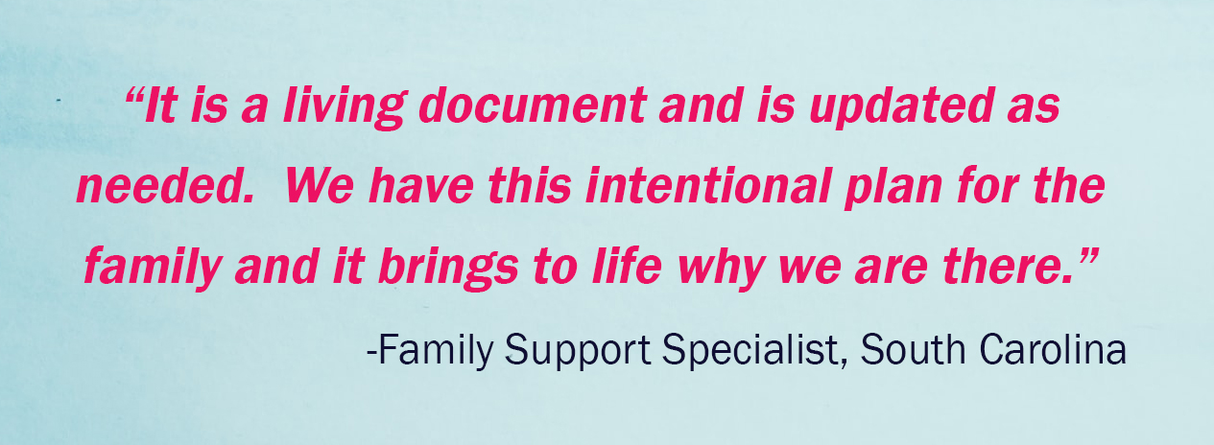

Slide 13

Spotlight Round Table
Children’s Wisconsin
Heidi Bartz, Supervisor
Erika Arzate, FSS
Children’s Wisconsin
Jackie Revels, Supervisor
Tory Stiehl, FSS
Healthy Families Visiting Nurse Association in Nebraska
  Jennifer Durand, HFA MSW Coordinator
  Maria Jacinto, FAW/FSW
Notes:
Panel Member Names

Slide 14

Service Plan Spotlight Questions & Answers
https://www.surveymonkey.com/r/YM8BXD2

